Slide 1

Analyzing mygov.in suggestions
(mann-ki-baat)

Slide 2
Implementation Process
Data Mining using beautiful soup
Storing the pre processed data
Storing the data in a txt file
Clustering
Kmeans Algorithm
Nltk implementation
(preprocessing)
Classification based on likes

Slide 3
Data Mining using Beautiful Soup
Beautiful Soup is an application framework for crawling web sites and extracting structured data which can be used for a wide range of useful applications, like data mining, information processing or historical archival.
It was originally designed for web scraping, it can also be used to extract data using APIs (such as Amazon Associates Web Services) or as a general purpose web crawler.
Command to install scrappy in Linux :
$ pip install scrapy

Slide 4
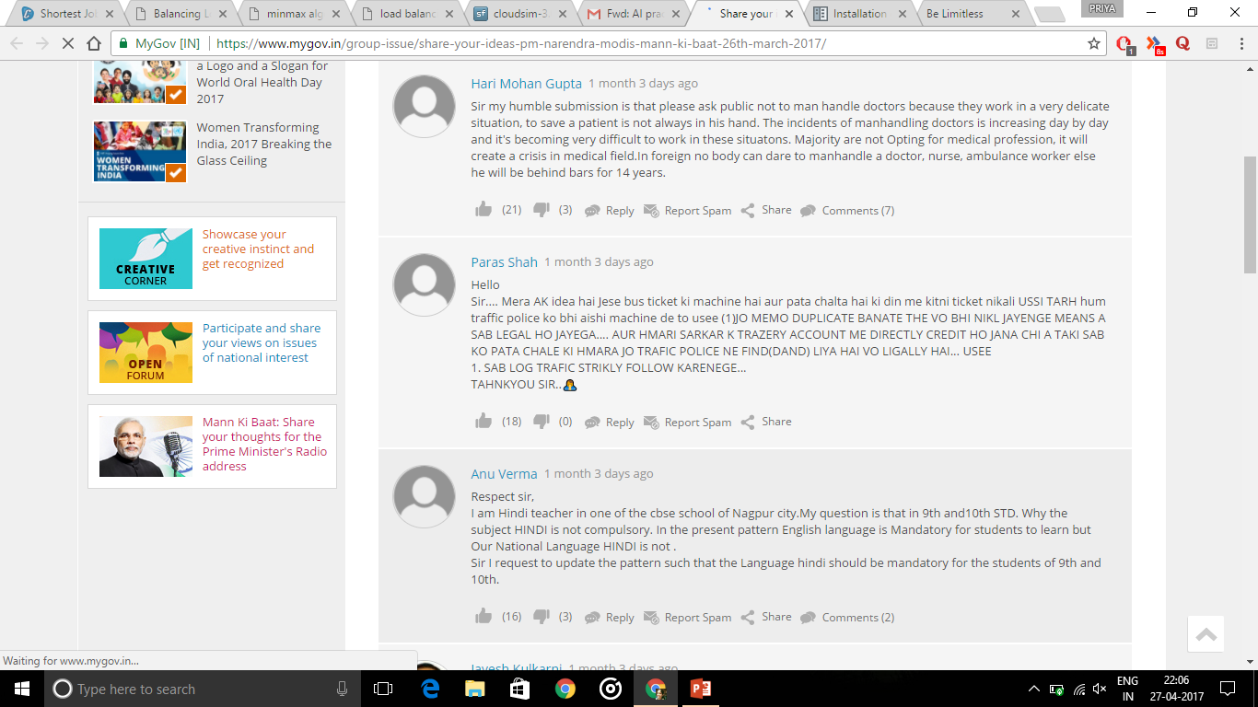
Suggestions To Be Scrapped Off

Slide 5
<div class="comment_body"><p>
Sir my humble submission is that please ask public not to man handle doctors because they work in a very delicate situation, to save a patient is not always in his hand. The incidents of manhandling doctors is increasing day by day and it's becoming very difficult to work in these situatons. Majority are not Opting for medical profession, it will create a crisis in medical field.In foreign no body can dare to manhandle a doctor, nurse, ambulance worker else he will be behind bars for 14 years.</p>
</div>
</div>
<div class="comment_extra_links">
<div class="voting_wrap">

Slide 6
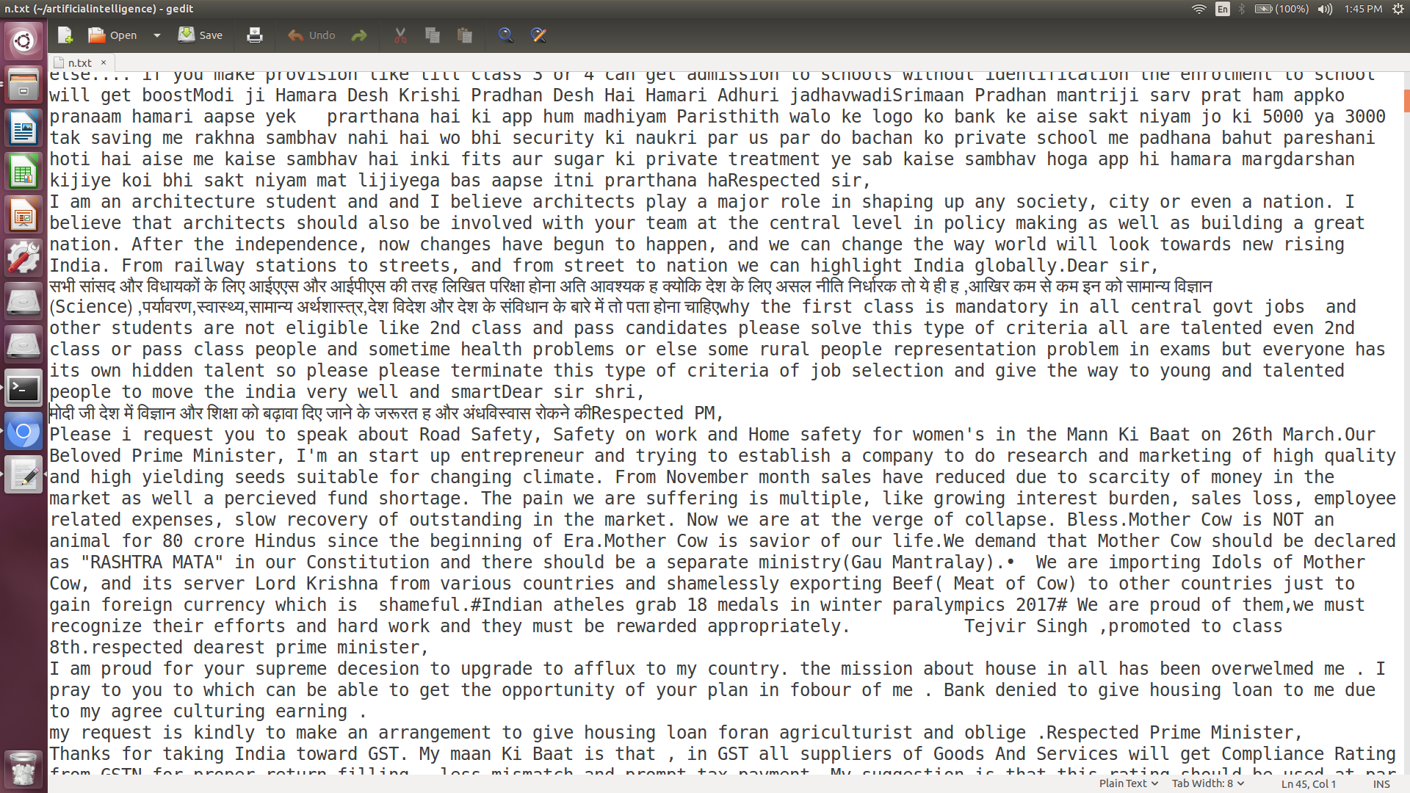
.txt file formed

Slide 7
Nltk implementation
NLTK is a platform for building Python programs to work with human language data.
It provides easy-to-use interfaces, such as WordNet, along with a suite of text processing libraries for classification, tokenization, stemming, tagging, parsing, and semantic reasoning etc.
NLTK has been called “a wonderful tool for teaching, and working in, computational linguistics using Python,” and “an amazing library to play with natural language.”
Natural Language Processing with Python provides a introduction to programming for language processing. It guides one through the fundamentals of writing programs, categorizing text, analyzing linguistic structure, and more.

Slide 8
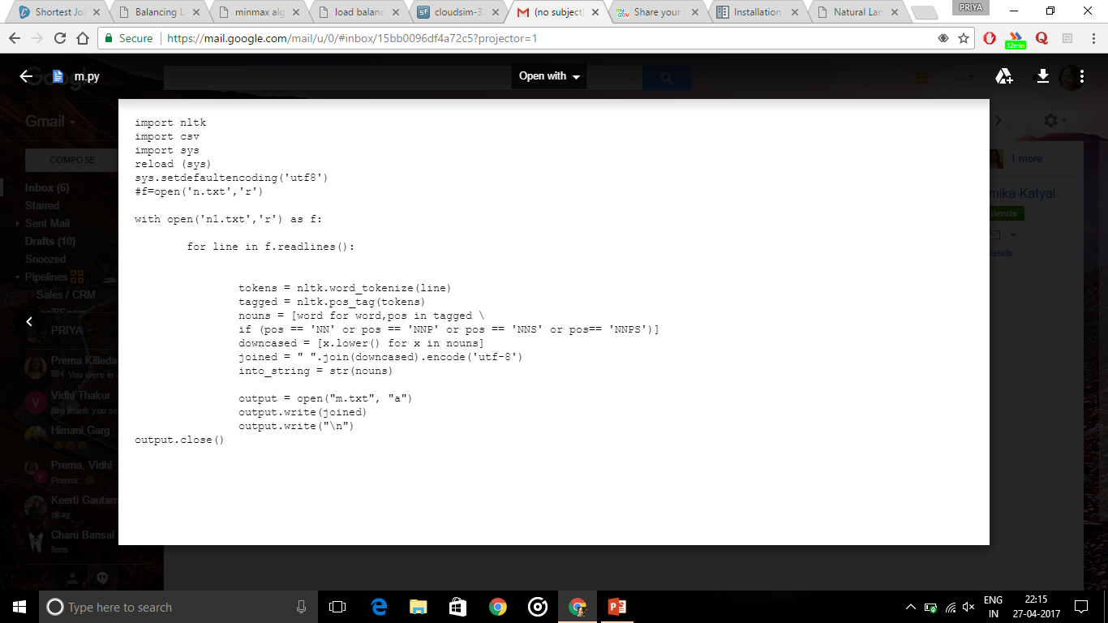
Code to separate noun from a .txt file

Slide 9
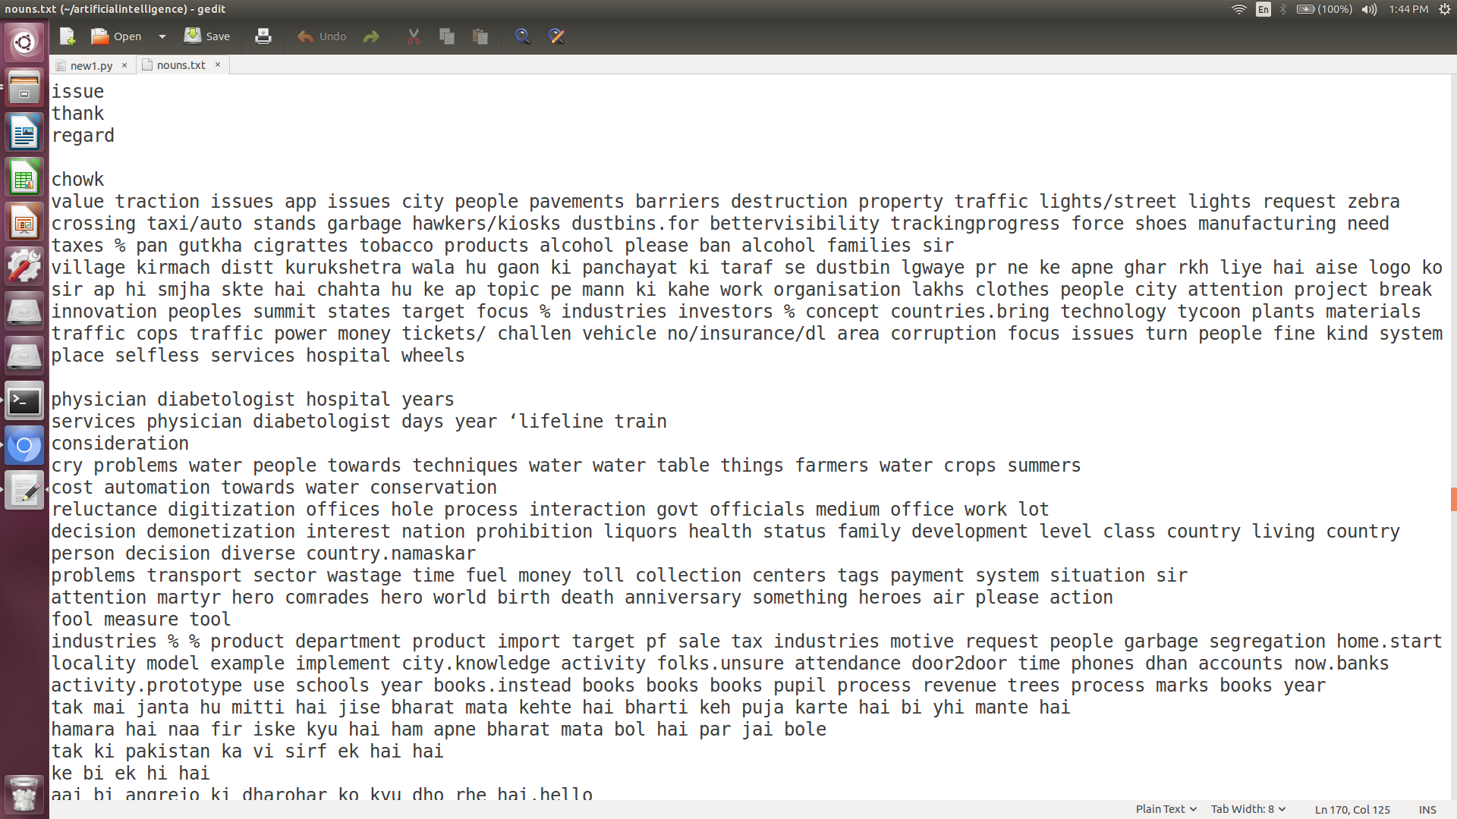
Output

Slide 10
Application of clustering algorithm, i.e., KMeans
k-means clustering is a method of vector quantization, used for cluster analysis in data mining. k-means clustering aims to partition n observations into k clusters in which each observation belongs to the cluster with the nearest mean, serving as a prototype of the cluster.
A distance measure is needed to determine the “closeness” of instances.
Classify an instance by finding its nearest neighbors and picking the most popular class among the neighbors.

Slide 11
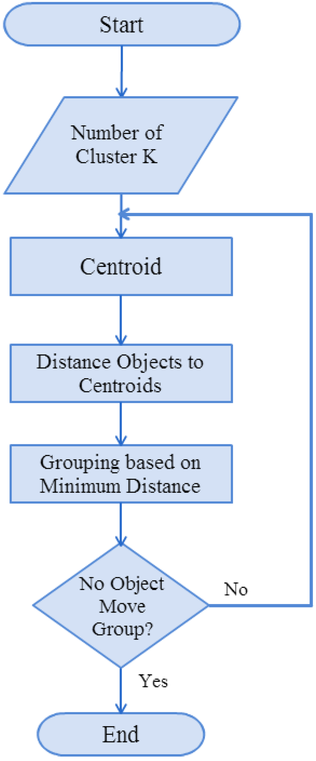

Slide 12
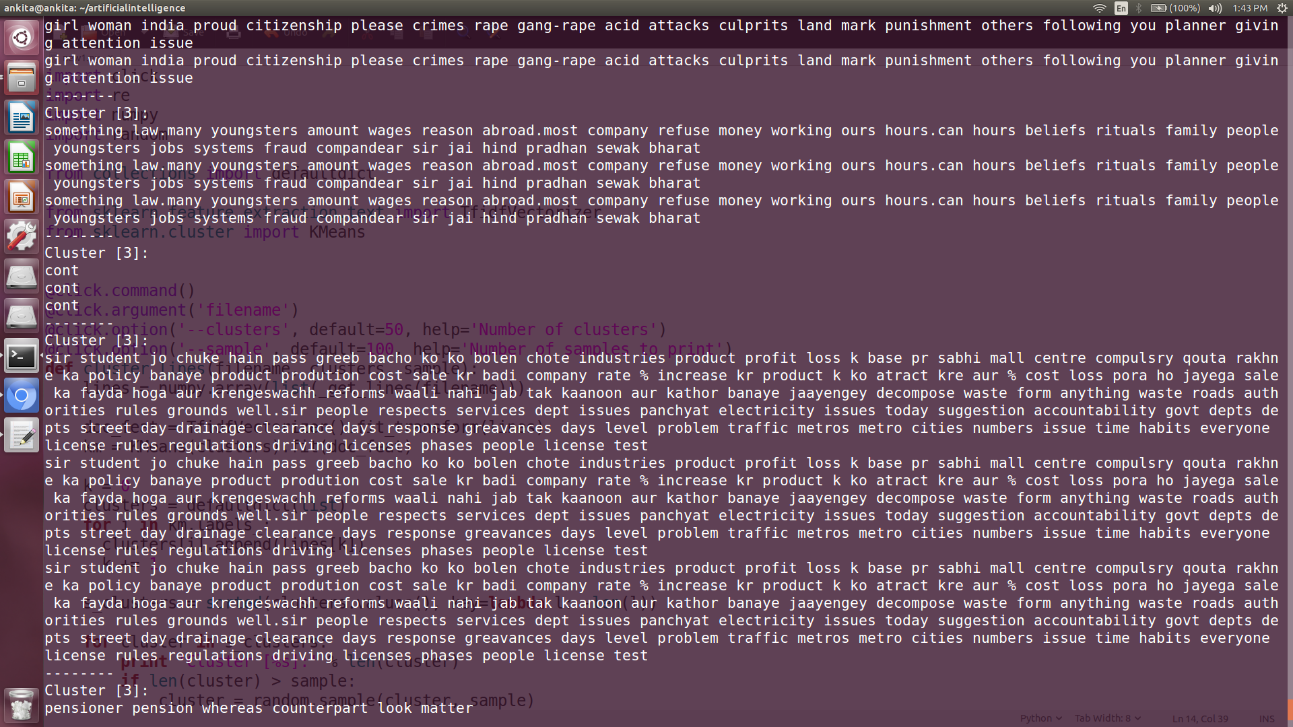
Clusters formed after application of K Means Algorithm

Slide 13
Segregating Data on the basis of likes

Slide 14
<span>
<a class="like_count" title="Login to Like" href=" https://www.mygov.in/user/login?r=node%2F267721%3Ffield_hashtags_tid%3D%26sort_by%3Dcreated%26sort_order%3DDESC%2F%23comment-wrapper-101096511">Like</a>
<span class="like_count_value">(21)</span>
</span>

Slide 15
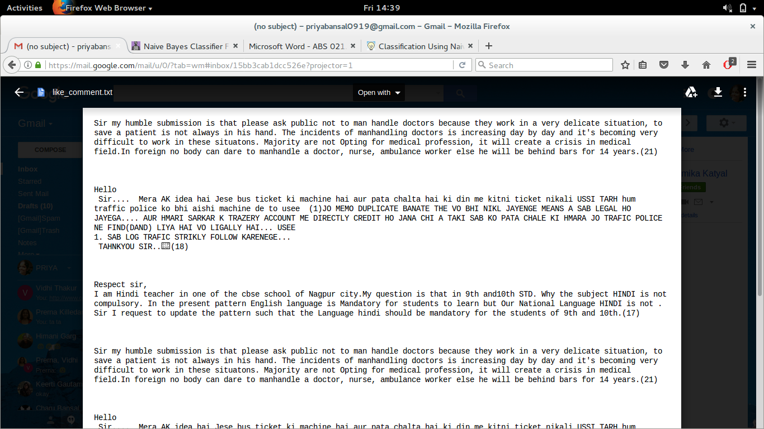

Slide 16
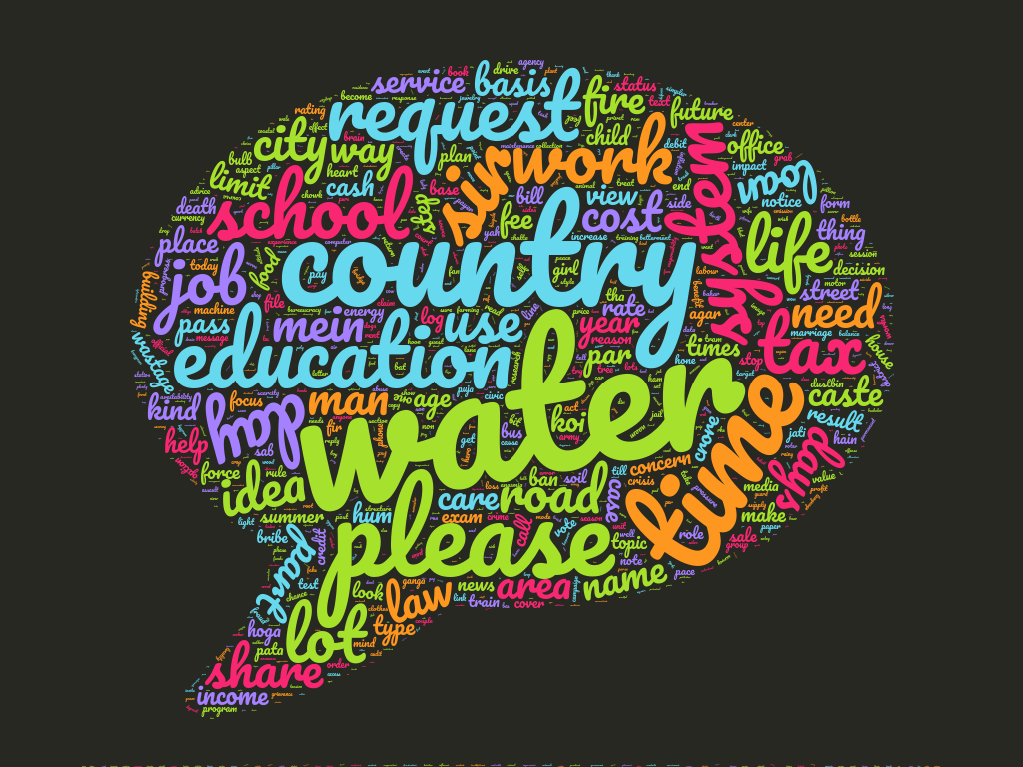

Slide 17
Presented By:
Ankita Jain(001)
Aishwarya Gupta(035)
Anamika Katyal(039)
Nitika Jain(040)
Priya Bansal(075)
Prerna Killedar(076)

